Slide 1
Assignment 2 Hints

Slide 2
Lab 2.1

Slide 3
Getting Started
Keep notes of what you are doing/results/answering specific questions in the notes.txt file
Open Scratch Buffer
Run 'emacs'
From inside emacs session, open scratch buffer (C-x b then enter)
Type a LISP expression, and evaluate with C-j
Try (+ 1 2) to start or something simple

Slide 4
Using expt to check 2^3^4
If a number fits within a 64 bit signed integer, it needs to be less than 2^63
You can write this as a simple LISP expression.
(if (…)
t
nil)
Without relying on the code try to think whether 2^3^4 fits within 63 bits

Slide 5
Checking function meanings
Mostly follow instructions here, try to experiment when in doubt
If you have trouble using the M-SPC hotkey,
You can access the description through the C-h b menu
You can use the function directly by name with 'M-x just-one-space'

Slide 6
Lab 2.2

Slide 7
DISCLAIMER
The next slide shows a simplified implementation of what-line
It is a bit different than what is found in Emacs. There is some syntactical changes, but the main thing is the Emacs version accounts for a separate case where the buffer is "narrowed".
You do NOT need to account for this case, so feel free to use the next slide as a basis to begin your lab 2.2 work

Slide 8
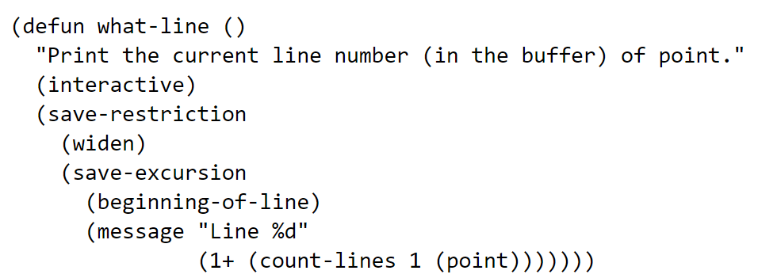
M-x what-line
Important things to look at
(interactive) -> means user can call it from emacs
Calls a 'count-lines' function
Point is a predefined function
There is a set of terms, "save-restriction", "widen", "save-excursion" which deal with if a user "narrows" the region of the page. See more here

Slide 9
Other built-in functions which may be useful
point-min
The "minimum" point of the page/narrowed region
Usually 1, but maybe different if page is narrowed
point-max
The "maximum" point of the page/narrowed region
Usually (1+ (buffer-size)) but maybe different if page is narrowed
line-number-at-pos
Gives you the line number of your current position
Defined right below "what-line" in simple.el
char-before
Given a location, determines the character (value) before that location

Slide 10
So how to create which-line?
Try to use as much of the built-in LISP parts as possible
Use "what-line" as a base, and modify it
Load into emacs, and test!
M-x load-file filepath
M-x which-line
Remember to test the edge-case of an empty file! If you open an empty file with emacs and run which-line you would see either:
'Line 1 of 0'
'Line 0 of 0'

Slide 11
Homework

Slide 12
The Goal
Write a Python 3 Script that has roughly same behavior as the shuf command
Check man shuf
When in doubt, try shuf command to check behavior of various scenarios
How will you call your script?
python3 /path/to/shuf.py [OPTIONS]

Slide 13
Terminology
Optional Arguments
Start with single or double hyphens
May have 0 or more values specified
Usually, any order is valid
Positional Arguments
No hyphens
Meaning comes from location in the command, after processing optional arguments
Can still be "optional" in the sense that a user does not need to provide it
shuf –n 5 file.txt
-n is an optional argument with value 5
file.txt is a positional argument, which comes after shuf

Slide 14
Better understanding the specs
Spec Says:
Your program should also support zero non-option arguments or a single non-option argument "-" (either of which means read from standard input), or a single non-option argument other than "-" (which specifies the input file name).
What that means:
Other than the optional arguments (-e, -i, -n, -r, --help) shuf.py takes no positional arguments or one positional argument. In the case of one positional argument, than it must be either a filename or the "-". In the case of "-", then the behavior is the same as not providing a positional argument which is that shuf.py should read from stdin.

Slide 15
Some basic examples of Input Options
python3 shuf.py
Script reads from stdin, so you can type multiple lines (each followed by enter), and then hit Ctrl-D to indicate end of input. The program will print the input lines in random order
python3 shuf.py -
Same as above
python3 shuf.py FILE
The script will read all the lines from the file, and print them out in a random order
python3 shuf.py –e ARG1 ARG2 ARG3 ARG4
Script reads the characters after –e as the input. So Line 1 is ARG1, Line 2 is ARG2, etc
python3 shuf.py –i LO-HI
The script will generate input based on the number range from LO-HI. So if the range is 5-10, then line 1 will be 5, line 2 will be 6, etc.
NOTE – All of these input arguments are mutually exclusive of each other

Slide 16
Examples Cont
Python3 shuf.py --head-count (or -n) COUNT
Can be combined with any of the other arguments
Should observe the same input behavior, but only printing COUNT number of lines
python3 shuf.py --repeat (or –r)
Can be combined with any of the other arguments
Should observe the same input behavior, but now can print the same output line multiple times.
python3 shuf.py –i 5-10 –r –n 7
Input is 6 lines with contents (5, 6, 7, 8, 9, 10). Print up to 7 lines in random order, and can repeat any of the lines when printing.
python3 shuf.py --help (or –h)
Prints the usage/help message based

Slide 17
Argparse
To parse the arguments, you'll want to use the Argparse library
Tutorial: https://docs.python.org/3/howto/argparse.html
Reference Docs: https://docs.python.org/3/library/argparse.html
Things to look for:
Argparse generates a usage message for you. That can be enough as long as you provide the string describing each argument
Optional vs Positional Arguments are defined by the name. Optional arguments have a – in front
Other useful parameters for add_argument():
action
nargs
default
dest

Slide 18
Starting Point
Check commented version of randline.py on CCLE for details on what each line/function does.
You can use the below as a Python3 and ArgParse starting point

Slide 19
Big Picture Idea
Try to separate your code into a few different sections:
Collect and Parse all the Command Line Arguments. Two main types of arguments
Input argument – where does the data come from
No argument/STDIN
File
-i
-e
Output argument – How will you print the now shuffled data
No argument
-r
-n
Based on the input options (nothing/stdin, file, -i, or -e), store each line of the input into some data structure
Shuffle the lines
Based on the output options (nothing, -r, or -n), print the input lines in a shuffled order

Slide 20
Last Misc. things to Check
Try running shuf.py with python2 and python3 and comment on any differences
Submit everything in a assign2.tgz file

